Slide 1
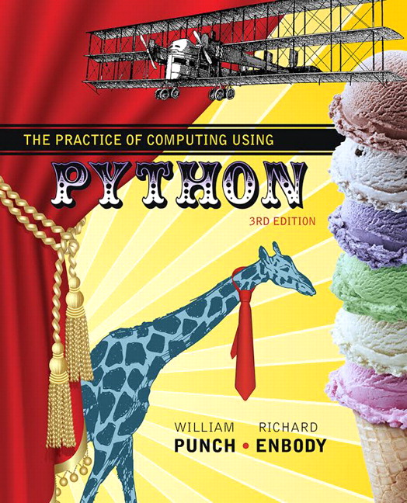
The Practice of Computing Using Python
Third Edition
Chapter 1
Beginnings
Slides in this presentation contains hyperlinks. JAWS users should be able to get a list of links by using INSERT+F7
Copyright © 2017, 2013, 2011 Pearson Education, Inc. All Rights Reserved
Notes:
If this PowerPoint presentation contains mathematical equations, you may need to check that your computer has the following installed:
1) MathType Plugin
2) Math Player (free versions available)
3) NVDA Reader (free versions available)

Slide 2
The Three Rules
Rule 1: Think before you program
Rule 2: A program is a human-readable essay on problem solving that also happens to execute on a computer
Rule 3: The best way to improve your programming and problem solving skills is to practice.

Slide 3
What is a Computer Program?

Slide 4
Program
A program is a sequence of instructions.
To run a program is to:
create the sequence of instructions according to your design and the language rules
turn that program into the binary commands the processor understands
give the binary code to the O S, so it can give it to the processor
O S tells the processor to run the program
when finished (or it dies :-), O S cleans up.

Slide 5
Interpreted
Python is an interpreted language
interpreted means that Python looks at each instruction, one at a time, and turns that instruction into something that can be run.
That means that you can simply open the Python interpreter and enter instructions one-at-a-time.
You can also import a program which causes the instructions in the program to be executed, as if you had typed them in.
To rerun an imported program you reload it.

Slide 6
Your First Program QuickStart 1

Slide 7
Code Listing 1.1

Slide 8
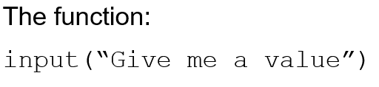
Getting Input
prints “Give me a value” on the python screen and waits till the user types something (anything), ending with Enter
Warning, it returns a string (sequence of characters), no matter what is given, even a number ('1' is not the same as 1, different types)

Slide 9
Import of Math
One thing we did was to import the math module with import math
This brought in python statements to support math (try it in the python window)
We precede all operations of math with math.xxx
math.pi, for example, is pi. math.pow(x,y) raises x to the y^{th} power.

Slide 10
Assignment
The = sign is the assignment statement
The value on the right is associated with the variable name on the left
It does not stand for equality!
More on this later

Slide 11
Conversion
Convert from string to integer
Python requires that you must convert a sequence of characters to an integer
Once converted, we can do math on the integers

Slide 12
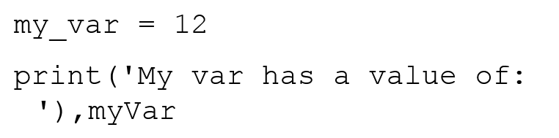
Printing Output
print takes a list of elements in parentheses separated by commas
if the element is a string, prints it as is
if the element is a variable, prints the value associated with the variable
after printing, moves on to a new line of output

Slide 13
At the Core of any Language
Control the flow of the program
Construct and access data elements
Operate on data elements
Construct functions
Construct classes
Libraries and built-in classes

Slide 14
Save as a “Module”
When you save a file, such as our first program, and place a .py suffix on it, it becomes a python module
You run the module from the IDLE menu to see the results of the operation
A module is just a file of python commands

Slide 15
Errors
If there are interpreter errors, that is Python cannot run your code because the code is somehow malformed, you get an error
You can them import the program again until there are no errors

Slide 16
Common Error
Using IDLE, if you save the file without a .py suffix, it will stop colorizing and formatting the file.
Resave with the .py, everything is fine

Slide 17
Syntax
Lexical components.
A Python program is:.
A module (perhaps more than one)
Each module has python statements
Each statement has expressions

Slide 18
Modules 1
We’ve seen modules already, they are essentially files with Python statements.
There are modules provided by Python to perform common tasks (math, database, web interaction, etc.)
The wealth of these modules is one of the great features of Python

Slide 19
Statements
Statements are commands in Python.
They perform some action, often called a side effect, but they do not return any values

Slide 20
Expressions
Expressions perform some operation and return a value
Expressions can act as statements, but statements cannot act as expressions (more on this later).
Expressions typically do not modify values in the interpreter

Slide 21
Side Effects and Returns
What is the difference between side effect and return?
1 + 2 returns a value (it's an expression). You can “catch”/assign the return value. However, nothing else changed as a result
print("hello")doesn't return anything, but something else, the side effect, did happen. Something printed!

Slide 22
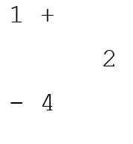
Whitespace
White space are characters that don't print (blanks, tabs, carriage returns etc.
For the most part, you can place white space (spaces) anywhere in your program
use it to make a program more readable

Slide 23
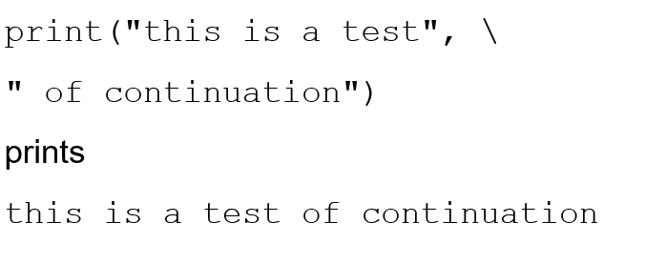
Continuation
However, python is sensitive to end of line stuff. To make a line continue, use the \

Slide 24
Also, Tabbing is Special
The use of tabs is also something that Python is sensitive to.
We’ll see more of that when we get to control, but be aware that the tab character has meaning to Python

Slide 25
Python comments
A comment begins with a # (pound sign)
This means that from the # to the end of that line, nothing will be interpreted by Python.
You can write information that will help the reader with the code

Slide 26
Code as Essay, an Aside
What is the primary goal of writing code:
To get it to do something
An essay on my problem solving thoughts
Code is something to be read. You provide comments to help readability.

Slide 27
Knuth, Literate Programming (84)
The practitioner of … programming can be regarded as an essayist, whose main concern is with exposition and excellence of style. Such an author, with thesaurus in hand, chooses the names of variables carefully and explains what each variable means. He or she strives for a program that is comprehensible because its concepts have been introduced in an order that is best for human understanding, using a mixture of formal and informal methods that reinforce each other.

Slide 28
Some of the details
Ok, there are some details you have to get used to.
Let’s look at the syntax stuff
We’ll pick more up as we go along

Slide 29
Python Tokens
Keywords:
You cannot use (are prevented from using) them in a variable name
and | del | from | not | while
as | elif | global | or | with
assert | else | if | pass | yield
break | except | import | print | Blank
class | exec | in | raise | Blank
continue | finally | is | return | Blank
def | for | lambda | try | Blank

Slide 30
Python Operators
Reserved operators in Python (expressions)
+ | - | * | ** | / | // | %
<< | >> | & | | | ^ | ~
< | > | <= | >= | == | != | <>

Slide 31
Python Punctuators
Python punctuation/delimiters ($ and ? not allowed).
‘ | “ | # | \ | blank | blank | blank
( | ) | [ | ] | { | } | @
, | : | . | ` | = | ; | blank
+= | -= | *= | /= | //= | %= | blank
&= | |= | ^= | >>= | <<= | **= | blank

Slide 32
Literals
Literal is a programming notation for a fixed value.
For example, 123 is a fixed value, an integer
it would be weird if the symbol 123's value could change to be 3.14!

Slide 33
Python Name Conventions
must begin with a letter or underscore _
Ab_123 is OK, but 123_ABC is not.
may contain letters, digits, and underscores
this_is_an_identifier_123
may be of any length
upper and lower case letters are different
Length_Of_Rope is not length_of_rope
names starting with _ (underline) have special meaning. Be careful!

Slide 34
Naming Conventions
Fully described by P E P8 or Google Style Guide for Python
http://google-styleguide.googlecode.com/svn/trunk/pyguide.html
The standard way for most things named in python is lower with under, lower case with separate words joined by an underline:
this_is_a_var
my_list
square_root_function

Slide 35
Rule 4
A foolish consistency is the hobgoblin of little minds
Quote from Ralph Waldo Emerson
We name things using conventions, but admit that, under the right circumstances, we do what is necessary to help readability.

Slide 36
Variable
A variable is a name we designate to represent an object (number, data structure, function, etc.) in our program
We use names to make our program more readable, so that the object is easily understood in the program

Slide 37

Variable Objects
Python maintains a list of pairs for every variable:
Variable's name
Variable's value
A variable is created when a value is assigned the first time. It associates a name and a value
Subsequent assignments update the associated value.
We say name references value
Name | Value
my_int | 7

Slide 38
Namespace
A namespace is the table that contains the association of a name with a value
We will see more about namespaces as we get further into Python, but it is an essential part of the language.

Slide 39
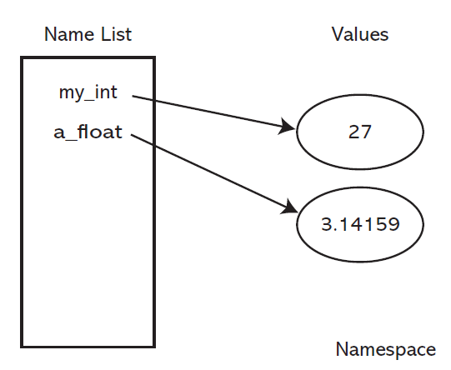
Variable Creation and Assignment
Figure 1.1 Namespace containing variable names and associated values.

Slide 40

When = doesn’t Mean Equal
It is most confusing at first to see the following kind of expression:
You don't have to be a math genius to figure out something is wrong there.
What's wrong is that = doesn't mean equal

Slide 41
= is assignment
In many computer languages, = means assignment.
my_int = my_int + 7
lhs = rhs
What assignment means is:
evaluate the rhs of the =
take the resulting value and associate it with the name on the lhs

Slide 42
More Assignment
Example: my_var = 2 + 3 * 5
evaluate expression (2+3*5): 17
change the value of my_var to reference 17
Example (my_int has value 2):
my_int = my_int + 3
evaluate expression (my_int + 3): 5
change the value of my_int to reference 5

Slide 43
Objects and Types
FIGURE 1.2 Namespace before and after the final assignment.

Slide 44
Variables and Types
Python does not require you to pre-define what type can be associated with a variable
What type a variable holds can change
Nonetheless, knowing the type can be important for using the correct operation on a variable. Thus proper naming is important!

Slide 45
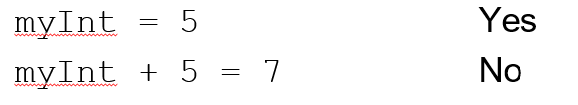
What can go on the lhs
There are limits therefore as to what can go on the lhs of an assignment statement.
The lhs must indicate a name with which a value can be associated
must follow the naming rules

Slide 46
Python “types”
Integers: 5
Floats: 1.2
Booleans: true
Strings: “anything” or ‘something’
Lists: [,] [‘a’,1,1.3]
Others we will see

Slide 47
What is a type
A type in Python essentially defines two things:
The internal structure of the type (what is contains)
The kinds of operations you can perform
'abc'.capitalize()is a method you can call on strings, but not integers
Some types have multiple elements (collections), we’ll see those later

Slide 48
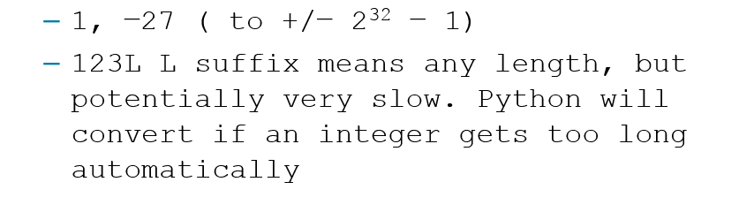
Fundamental Types
Integers
Floating Point (Real)
Booleans (True or False values)

Slide 49
Converting Types
A character ‘1’ is not an integer 1. We’ll see more on this later, but take my word for it.
You need to convert the value returned by the input command (characters) into an integer
int("123") yields the integer 123

Slide 50
Type Conversion
int(some_var)returns an integer
float(some_var)returns a float
str(some_var) returns a string
should check out what works:

Slide 51
Operators
Integer
addition and subtraction: +,−
multiplication: *
division
quotient: /
integer quotient: //
remainder: %
Floating point
add, subtract, multiply, divide: +, −, *, /

Slide 52
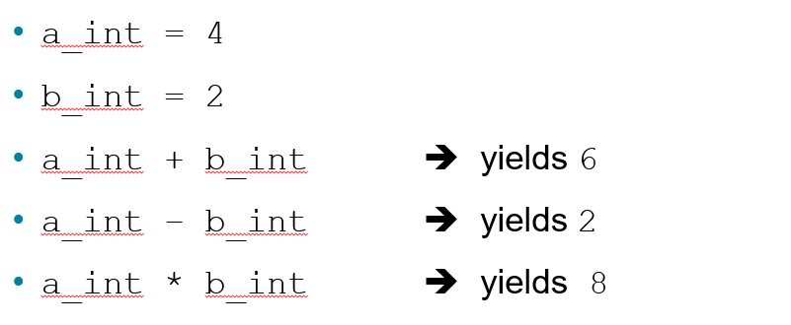
Binary Operators
The operators addition(+), subtraction(−) and multiplication(*) work normally:

Slide 53
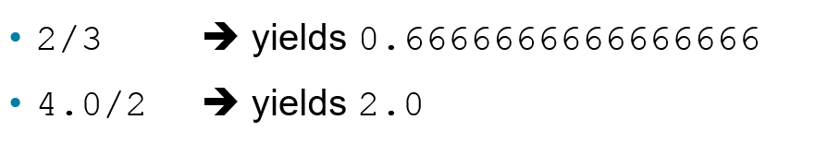
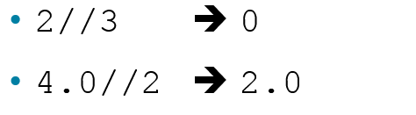
Two Types of Division
The standard division operator (/) yields a floating point result no matter the type of its operands:
Integer division (//) yields only the integer part of the divide (its type depends on its operands):

Slide 54
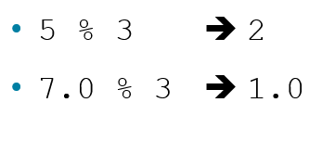
Modulus Operator
The modulus operator (%) give the integer remainder of division:
Again, the type of the result depends on the type of the operands.

Slide 55
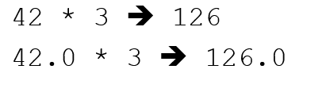
Mixed Types
What is the difference between 42 and 42.0 ?
their types: the first is an integer, the second is a float
What happens when you mix types:
done so no information is lost

Slide 56
Integer Operators
FIGURE 1.3 Long division example.

Slide 57
Order of Operations and Parentheses
Operator | Description
() | Parenthesis (grouping)
** | Exponentiation
+x, −x | Positive, Negative
*,/,%,// | Multiplication, Division, Remainder, Quotient
+, − | Addition, Subtraction
Precedence of *,/ over +,−is the same, but there precedents for other operators as well
Remember, parentheses always takes precedence

Slide 58
Augmented Assignment
Shortcuts can be distracting, but one that is often used is augmented assignment:
Combines an operation and reassignment to the same variable
Useful for increment/decrement
Shortcut | Equivalence
my_int += 2 | my_int = my_int + 2
my_int −= 2 | my_int = my_int − 2
my_int /= 2 | my_int = my_int / 2
my_int *= 2 | my_int = my_int * 2

Slide 59
Modules 2
Modules are files that can be imported into your Python program.
Use other, well proven code with yours
Example is the math module
We import a module to use its contents
We use the name of the module as part of the content we imported

Slide 60
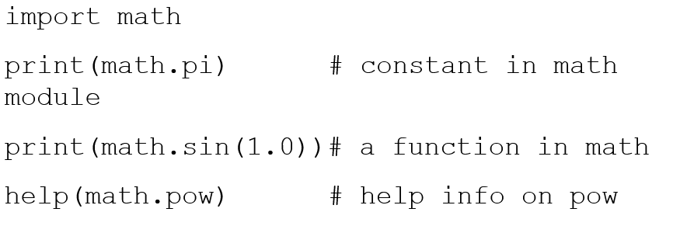
Math Module

Slide 61
Developing an Algorithm

Slide 62
Develop an Algorithm
How do we solve the following?
If one inch of rain falls on an acre of land, how many gallons of water have accumulated on that acre?

Slide 63
Algorithm
A method - a sequence of steps - that describes how to solve a problem of class of problems

Slide 64
Rule 5
Test your code, often and thoroughly!
One thing we learn in writing our code is that we must test it, especially against a number of conditions, to assure ourselves that it works
It turns out that testing is very hard and "correct" is a difficult thing to establish!

Slide 65
Code Listing 1.2-1.3

Slide 66
The Rules
Think before you program
A program is a human-readable essay on problem solving that also happens to execute on a computer.
The best way to improve your programming and problem solving skills is to practice.
A foolish consistency is the hobgoblin of little minds
Test your code, often and thoroughly!

Slide 67
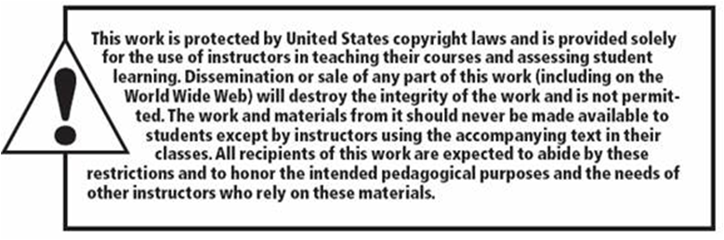
Copyright

